Slide 1

Covid 19 audio respiratory classification using Machine learning
(Machine learning)

Slide 2
Group Member Information
Krishna Vamsi G
Pravallika G
Suvidha M
Mahathi P

Slide 3
Role/Responsibilities and Contribution in project
Krishna Vamsi G handled data collection and analysis.
Pravallika G managed data preprocessing,
Suvidha M built and tuned the machine learning model.
Mahathi P created the Streamlit web application.

Slide 4

Motivation
Global health, the economy, and communities have all been significantly impacted by the COVID-19 pandemic, making it urgently necessary to develop reliable diagnostic techniques to locate the virus and stop its spread. Along with COVID-19, other respiratory illnesses including pertussis and influenza continue to pose serious health threats on a global scale. Reducing morbidity and mortality rates depends on early diagnosis and effective treatment of these disorders.
Chest X-rays and polymerase chain reaction (PCR) testing are two examples of traditional diagnostic techniques that can be time-consuming, expensive, and require experienced professionals to perform and interpret the results. A system that makes use of the auditory characteristics of respiratory sounds and machine learning models offers a viable alternative. A system like this would enable early identification and intervention, improving patient outcomes and reducing the strain on healthcare systems in the process.

Slide 5

Objectives
Make a system that can classify cough audio samples
Enhance the model's generalization skills and test its effectiveness on new data.
Machine learning algorithms are used together with powerful audio feature extraction techniques to distinguish between different respiratory ailments with accuracy.
Examine the model's performance using measures like recall, precision, and F1 score to find the essential characteristics in cough audio samples that help with categorization precision.
Contribution to the broader field of AI and ML in healthcare, highlighting the potential of cutting-edge technical solutions for tackling pressing global health issue

Slide 6
Related work
[1] The authors of this study used audio quality clustering and confidence measure-based learning methods for the detection of covid-19 using cough sounds. Audio segmentation methods for isolation of cough samples are done through cough event detection and segmentation procedure while confidence measure is proposed through inductive conformal prediction and class-agnostic conformal prediction as a non-conformity measure. The limitation of this study is the presence of background noise in the dataset collected which needs to be removed for improvement of analysis.
[2] The authors used audio spectrogram processing using deep learning models for early detection of covid-19 infections that included coughing, sneezing and other respiratory analysis. ImageNet-based Xception learning architecture was used and fine-tuned for better results. A precision between 0.75 and 0.8 is obtained using the Xception model, stochastic gradient descent, batch-sized hyperparameter tuning method, epoch, Flatten, ELU, softmax and Overfitting of data.
[3] the authors used clinically relevant sound-based features for the identification of covid-19 and performed a robustness assessment with the data-centric machine-learning pipeline. Data balancing and augmentation help mitigate the disproportionality of classes. Two datasets, Covid-19 audio respiratory dataset and the open-access Coswara dataset were used for testing the performance. The extra trees classifier model is used for modelling and 60-80% sensitivity is obtained as a result. The limitation of this study is the wide range of missing metadata in the dataset.

Slide 7
Problem Statement
Through the COVID-19 pandemic outbreak, major scientific efforts have been made concerning this field to find solutions on how to detect, cure and stop the infections of this viral disease. Along with the medical scholars and doctors around the world who contributed to a huge scale in tackling this pandemic, data scientists have also been working hard to collect and analyse different forms of data from the patients to understand the hidden patterns of cause and behaviour of this disease [4]. With the help of machine learning a lot of information has been found concerning the hidden patterns and variations in COVID-19 infections. However, further research studies are required to classify COVID-19 from other respiratory diseases using different forms of data such as audio data that comprises of sounds of cough, breath and speech of subjects. This data can be utilized to classify if the subject is suffering from COVID-19 based on patterns followed by their speech, cough or breath.
The audio data will be collected from the prepared databases of Kaggle for cough audio signal classification called CoughVid consisting of audio respiratory sounds which will be processed through audio data pre-processing steps and then EDA is performed. [5] Once the data is prepared, modelling is done using machine learning models

Slide 8
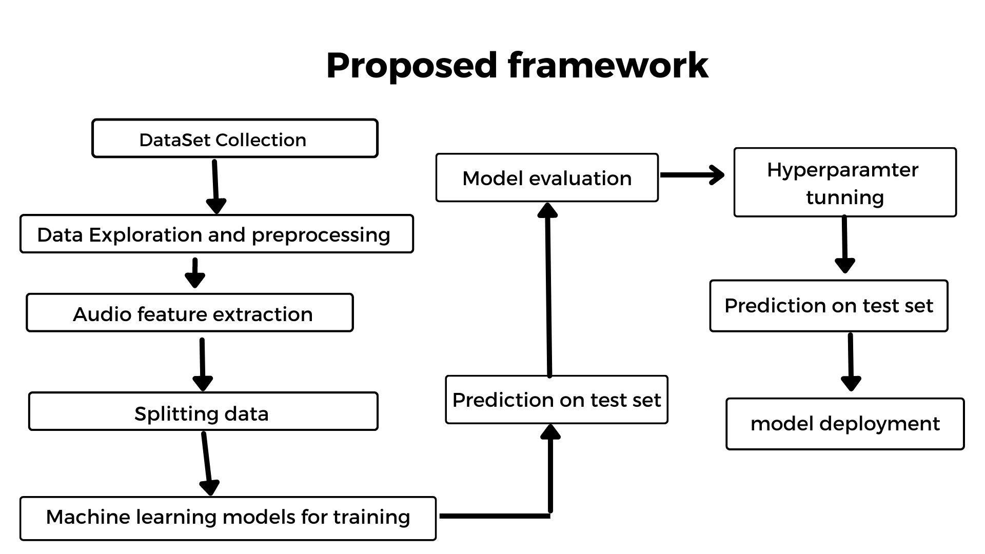
Proposed Solution

Slide 9
Results/Simulations
Algorithm | Precision | Recall | F1 score | Accuracy
Logistic regression | 84% | 88% | 86% | 91%
LGBM Classifier | 97% | 83% | 88% | 94%
Gradient Boosting Classifier | 97% | 83% | 88% | 94%

Slide 10
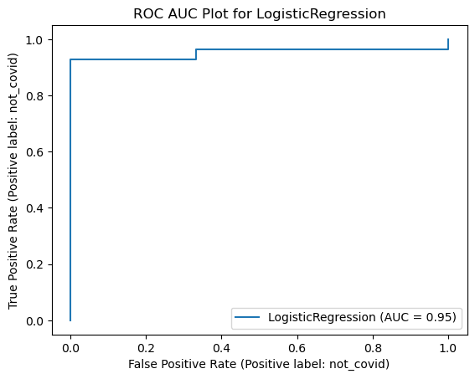
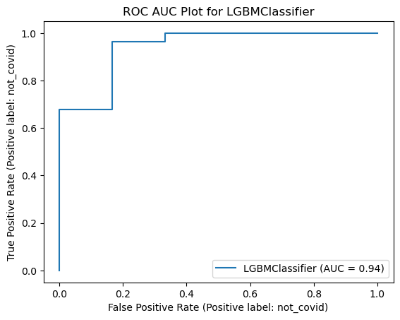
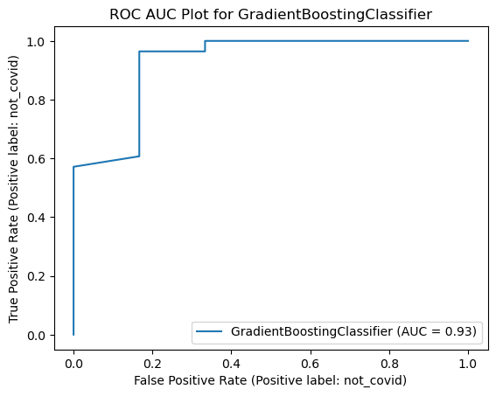
Results/Simulations

Slide 11
References
[1] A. E. Ashby et al., “Cough-based COVID-19 detection with audio quality clustering and confidence measure based learning Khuong An Nguyen,” Proc. Mach. Learn. Res., vol. 179, no. Ml, pp. 1–20, 2022.
[2] C. R. Rodriguez, D. Angeles, R. Chafloque, F. Kaseng, and B. Pandey, “Deep Learning Audio Spectrograms Processing to the Early COVID-19 Detection,” Proc. - 2020 12th Int. Conf. Comput. Intell. Commun. Networks, CICN 2020, pp. 429–434, 2020, doi: 10.1109/CICN49253.2020.9242583.
[3] P. Matias et al., “Clinically Relevant Sound-Based Features in COVID-19 Identification: Robustness Assessment With a Data-Centric Machine Learning Pipeline,” IEEE Access, vol. 10, no. June, pp. 105149–105168, 2022, doi: 10.1109/ACCESS.2022.3211295.
[4] S. Wang et al., “IMAGING INFORMATICS AND ARTIFICIAL INTELLIGENCE A deep learning algorithm using CT images to screen for Corona virus disease ( COVID-19 ),” pp. 6096–6104, 2021.
[5] I. D. Apostolopoulos and T. A. Mpesiana, “Covid-19: automatic detection from X-ray images utilizing transfer learning with convolutional neural networks,” Phys. Eng. Sci. Med., vol. 43, no. 2, pp. 635–640, 2020, doi: 10.1007/s13246-020-00865-4.

